Slide 1

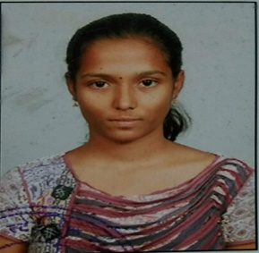


Andhra Loyola Institute of Engineering and Technology (Affiliated to JNTUK, Kakinada)
Project Presentation
SMART DRAINAGE MANAGEMENT SYSTEM
Department of Information Technology
Batch -12
Under the Guidance of :
G. Durvasi
Assistant Professor
V. Phani Sonika
16HP1A1224
G. Keerthi
16HP1A12215
T. Hepsiba Susan
16HP1A1213

Slide 2

Contents
Abstract
Problem
Our solution
Literature survey
Proposed system
Hardware and software requirements
Working
Modelling
Outputs
Conclusion
SMART DRAINAGE MANAGEMENT SYSTEM
CONTENTS
Batch -12 16HP1A1224 16HP1A1215 16HP1A1213
DEPARTMENT OF INFORMATION TECHNOLOGY

Slide 3

Abstract
Over flow of sewage on roads is been a major problem in many developed and under developed cities as well.
Drainage conditions should be monitored to ensure proper functioning.
All areas doesn't have proper monitoring teams.
Manual drainage monitoring is difficult and ineffective.
SMART DRAINAGE MANAGEMENT SYSTEM
Batch -12 16HP1A1224 16HP1A1215 16HP1A1213
ABSTRACT
DEPARTMENT OF INFORMATION TECHNOLOGY

Slide 4
This project is about developing a system which indicates manhole and drain pipes conditions to the municipality so that they can prevent problems.
Because “Prevention is better than cure.”
SMART DRAINAGE MANAGEMENT SYSTEM
Batch -12 16HP1A1224 16HP1A1215 16HP1A1213
ABSTRACT
DEPARTMENT OF INFORMATION TECHNOLOGY

Slide 5
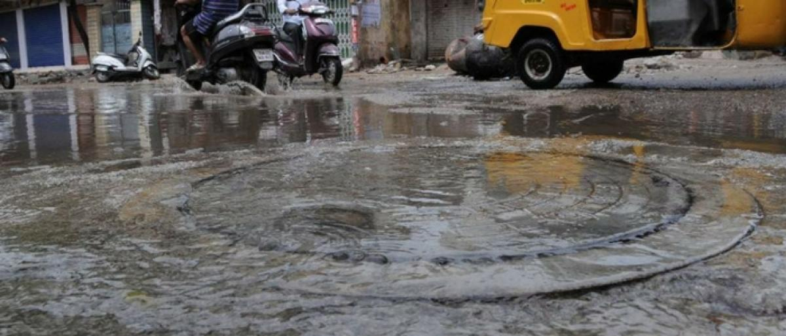

Problem
One of the major problem on a rainy day is overflowing of manholes and drainages on a road.
SMART DRAINAGE MANAGEMENT SYSTEM
Batch -12 16HP1A1224 16HP1A1215 16HP1A1213
PROBLEM
DEPARTMENT OF INFORMATION TECHNOLOGY

Slide 6
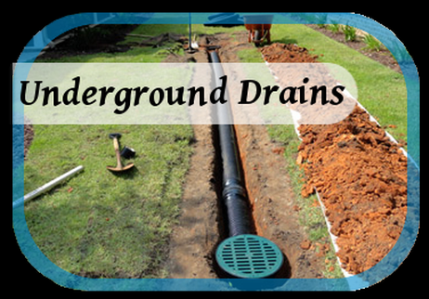
Another problem in drainage system is difficulty of finding blockage in underground drainage pipes.
SMART DRAINAGE MANAGEMENT SYSTEM
Batch -12 16HP1A1224 16HP1A1215 16HP1A1213
PROBLEM
DEPARTMENT OF INFORMATION TECHNOLOGY

Slide 7
Most of time drainage management team of municipality detects the problem in the drainage system when it is causes the trouble.
The main reason for this is manual monitoring because it’s difficult and some time it takes lots of time.
SMART DRAINAGE MANAGEMENT SYSTEM
Batch -12 16HP1A1224 16HP1A1215 16HP1A1213
PROBLEM
DEPARTMENT OF INFORMATION TECHNOLOGY

Slide 8
Solution
The main objective of this project is to keep the city clean, safety and healthy. And replace the manual work of drainage monitoring.
IoT can provide best solution for sewage monitoring problem.
Predictive drainage clogging system : The intelligence of sensors and predictive system identifies the drain is clogged and also gives us information of level of manhole filled so, action can be taken by authorities.
SMART DRAINAGE MANAGEMENT SYSTEM
SOLUTION
Batch -12 16HP1A1224 16HP1A1215 16HP1A1213
DEPARTMENT OF INFORMATION TECHNOLOGY

Slide 9
Completely connected: The sensors are communicated through Wi-Fi communication modules to share information.
This information can be viewed by authorized users at any time and any place in the internet.
SMART DRAINAGE MANAGEMENT SYSTEM
Batch -12 16HP1A1224 16HP1A1215 16HP1A1213
SOLUTION
DEPARTMENT OF INFORMATION TECHNOLOGY

Slide 10
Literature survey
Towards the implementation of IoT for environmental condition monitoring in homes
Authors: Sean Dieter Tebje Kelly, Nagender Kumar Suryadevera, and Subhas Chandra Mukhopadhyay, Fellow ,IEEE
The systems basic operations include remote management and control of domestic devices such as electric lamp ; water heater etc.
The framework of the monitoring system is based on a combination of widespread distributed sensing units, information system for the data collection, and reasoning and situation awareness.
SMART DRAINAGE MANAGEMENT SYSTEM
Batch -12 16HP1A1224 16HP1A1215 16HP1A1213
LITERATURRE SURVEY
DEPARTMENT OF INFORMATION TECHNOLOGY

Slide 11
On real-time performance of volcano-monitoring systems with wireless sensor networks.
Authors: Roman Lara, Member, Diego Benitez, Senior Member ,IEEE, Antonio Caamano, Marco Zennaro and Jose Luis Rojo- Alvarez
This journal paper discuss about early warning of a volcanic eruption using real-time(RT) systems.
In this wireless sensor networks(WSNs) may play a key role.
SMART DRAINAGE MANAGEMENT SYSTEM
Batch -12 16HP1A1224 16HP1A1215 16HP1A1213
LITERATURRE SURVEY
DEPARTMENT OF INFORMATION TECHNOLOGY

Slide 12
Proposed system
In this project, we design smart drainage management system using various sensors such as water flow, ultrasonic sensor.
Sensors to detect blockage, flood.
The intelligence of sensors and system will identify the clogging inside the drainage system and will give the status of the drainage system for every second.
SMART DRAINAGE MANAGEMENT SYSTEM
Batch -12 16HP1A1224 16HP1A1215 16HP1A1213
PROPOSED SYSTEM
DEPARTMENT OF INFORMATION TECHNOLOGY

Slide 13
The ultrasonic will determine the extent of the flood as low, medium or high. This will enhance early flood detection by which drainage workers can take precautions .
The water flow sensors will detect the blockage in the drain lines and provides the message so that we can clean it as early as possible.
These entire data will be collectively sent by the Node MCU will be stored at the cloud all these data will be accessible in real-time scenario for continuous monitoring.
SMART DRAINAGE MANAGEMENT SYSTEM
Batch -12 16HP1A1224 16HP1A1215 16HP1A1213
PROPOSED SYSTEM
DEPARTMENT OF INFORMATION TECHNOLOGY

Slide 14
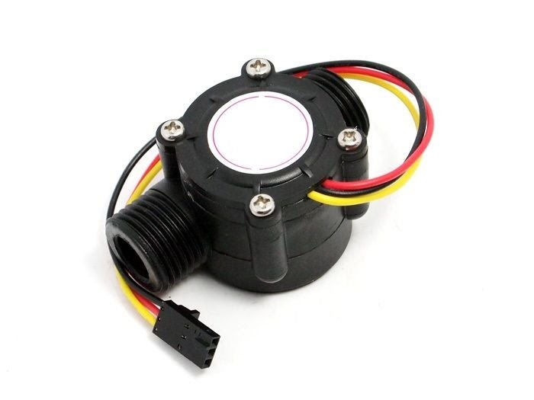
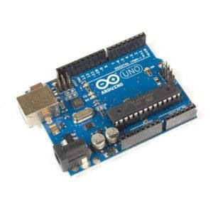
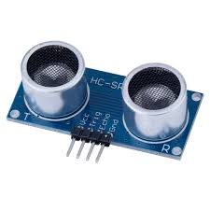
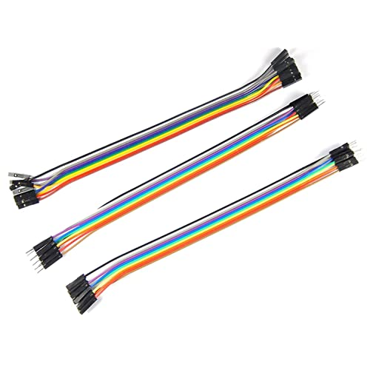
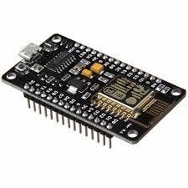
Hardware used
Arduino UNO
(At mega 328 – 8bit AVR microcontroller.)
Water flow sensor
(Model : SEN-HZ21WA-E)
Ultrasonic sensor
(HC-SR04 Ultrasonic Sensor)
Node MCU
Jumper wires
SMART DRAINAGE MANAGEMENT SYSTEM
Batch -12 16HP1A1224 16HP1A1215 16HP1A1213
HRADWARE USED
DEPARTMENT OF INFORMATION TECHNOLOGY

Slide 15
Software
Web Interface of IOT Cloud
AllThingsTalk
Operating system
Arduino IDE
Coding language
C/C++
SMART DRAINAGE MANAGEMENT SYSTEM
Batch -12 16HP1A1224 16HP1A1215 16HP1A1213
SOFTWARE
DEPARTMENT OF INFORMATION TECHNOLOGY

Slide 16
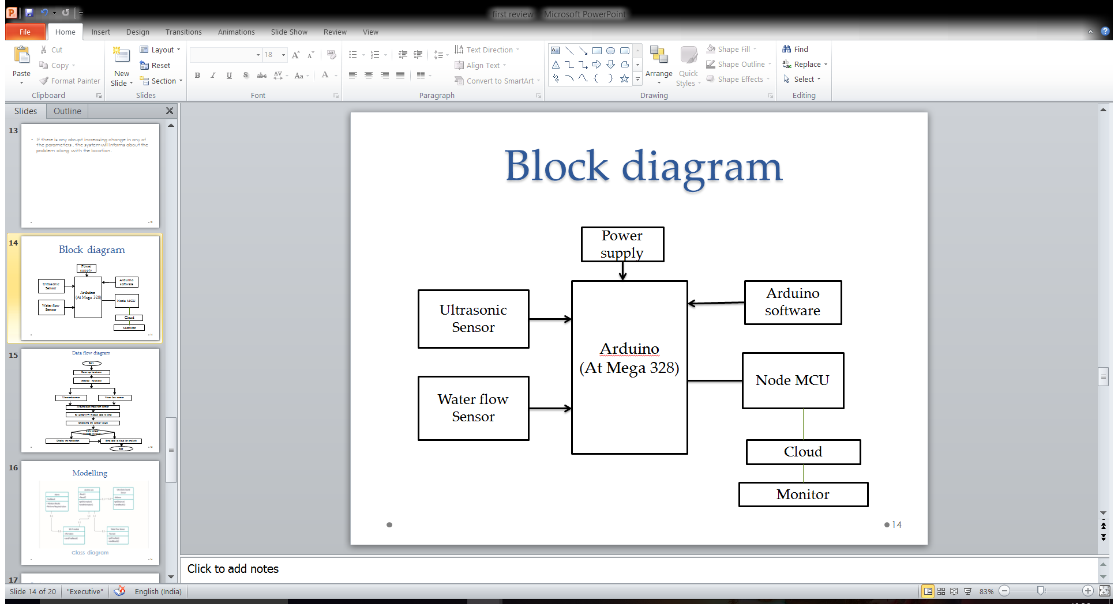
Block Diagram
SMART DRAINAGE MANAGEMENT SYSTEM
Batch -12 16HP1A1224 16HP1A1215 16HP1A1213
BLOCK DIAGRAM
DEPARTMENT OF INFORMATION TECHNOLOGY

Slide 17
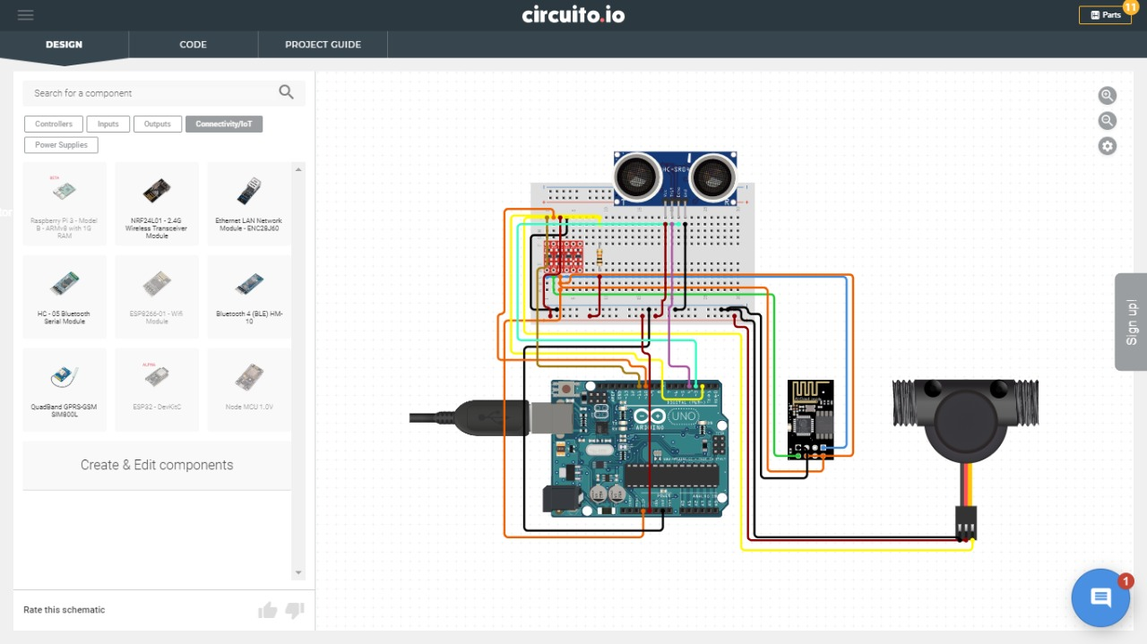
Circuit diagram of the setup
Ultrasonic Sensor
Wires connecting the circuit
Node MCU
Waterflow Sensor
USB for power supply
Ardunio
SMART DRAINAGE MANAGEMENT SYSTEM
Batch -12 16HP1A1224 16HP1A1215 16HP1A1213
BLOCK DIAGRAM
DEPARTMENT OF INFORMATION TECHNOLOGY

Slide 18
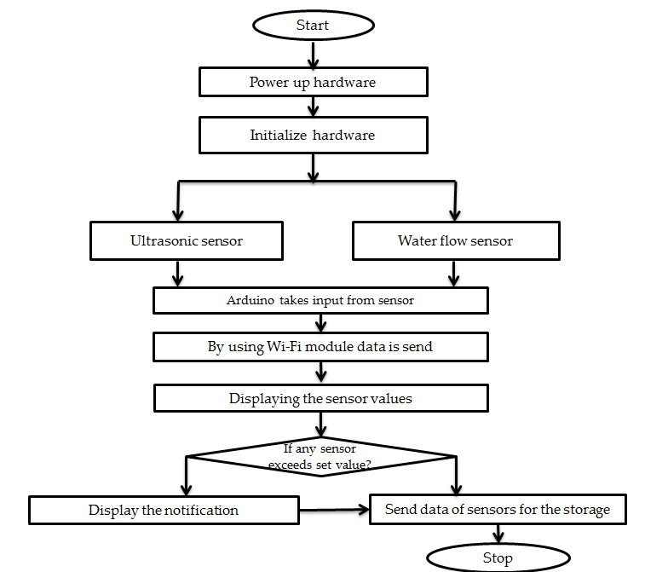
Flow diagram
SMART DRAINAGE MANAGEMENT SYSTEM
Batch -12 16HP1A1224 16HP1A1215 16HP1A1213
FLOW DIAGRAM
DEPARTMENT OF INFORMATION TECHNOLOGY

Slide 19
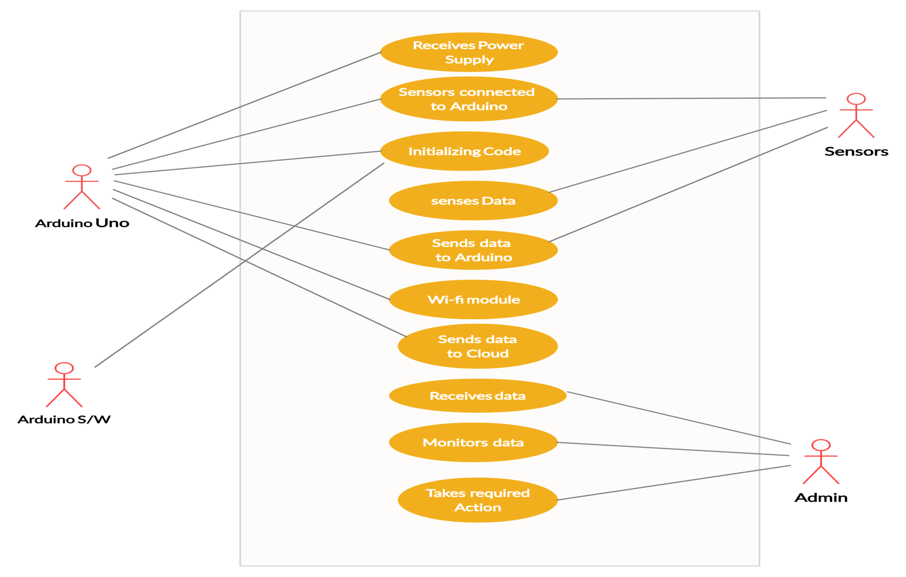
Modeling
Use Case Diagram
SMART DRAINAGE MANAGEMENT SYSTEM
Batch -12 16HP1A1224 16HP1A1215 16HP1A1213
MODELING
DEPARTMENT OF INFORMATION TECHNOLOGY

Slide 20
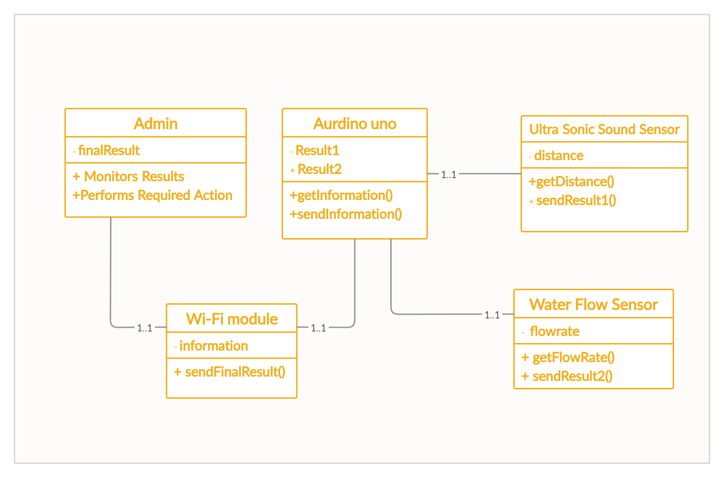
Class Diagram
SMART DRAINAGE MANAGEMENT SYSTEM
Batch -12 16HP1A1224 16HP1A1215 16HP1A1213
MODELING
DEPARTMENT OF INFORMATION TECHNOLOGY

Slide 21
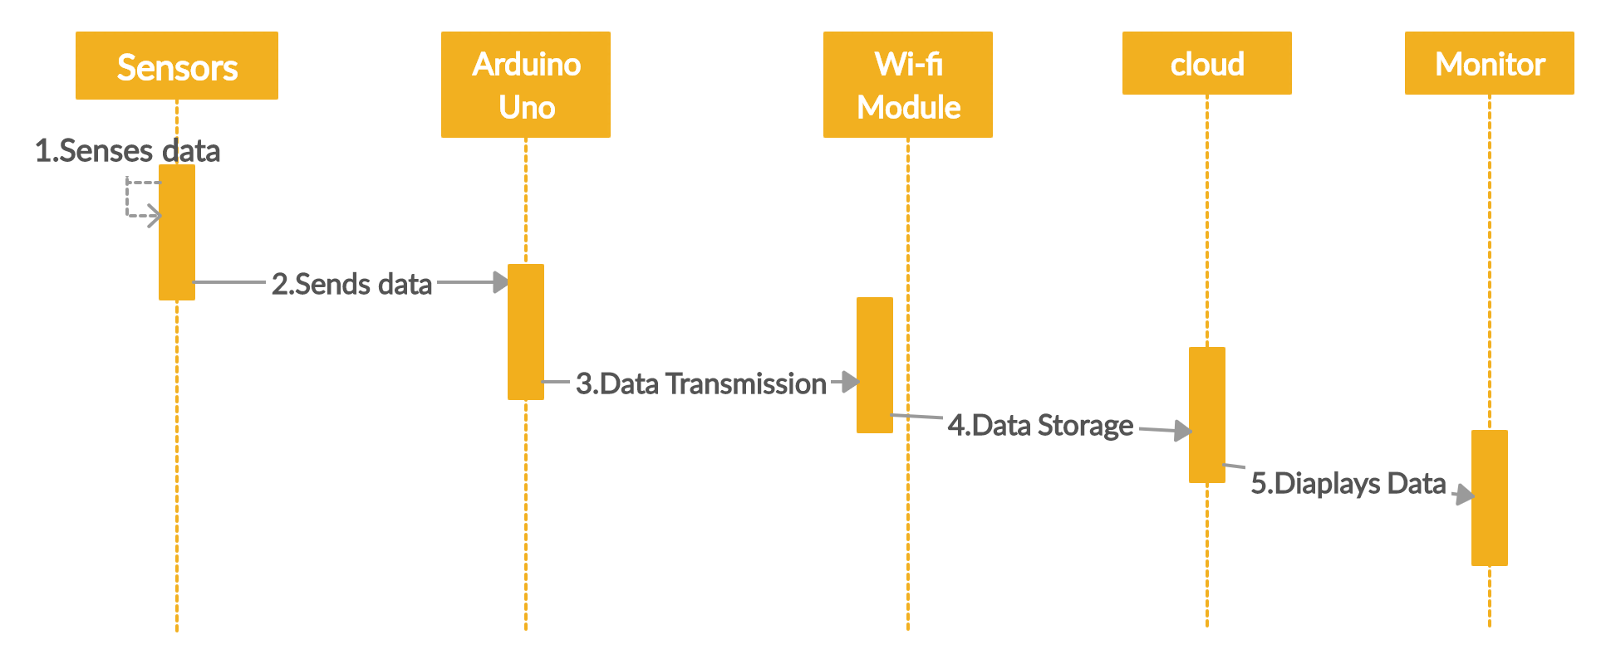
Sequence diagram
SMART DRAINAGE MANAGEMENT SYSTEM
Batch -12 16HP1A1224 16HP1A1215 16HP1A1213
MODELING
DEPARTMENT OF INFORMATION TECHNOLOGY

Slide 22
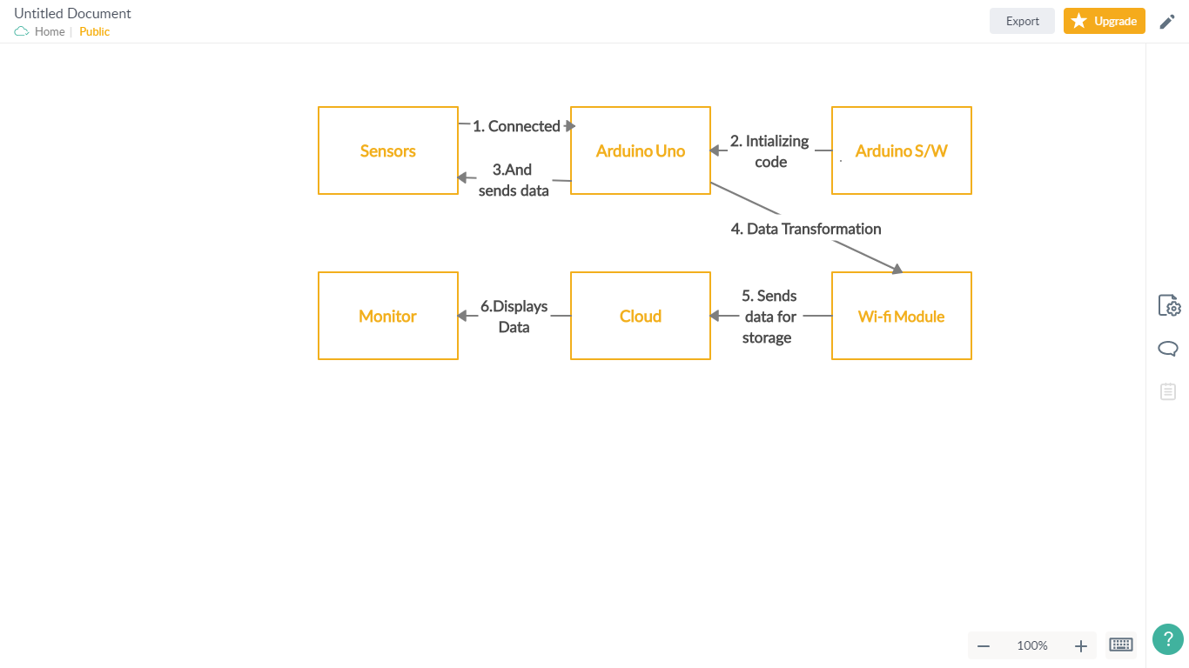
Collaboration Diagram
SMART DRAINAGE MANAGEMENT SYSTEM
Batch -12 16HP1A1224 16HP1A1215 16HP1A1213
MODELING
DEPARTMENT OF INFORMATION TECHNOLOGY

Slide 23
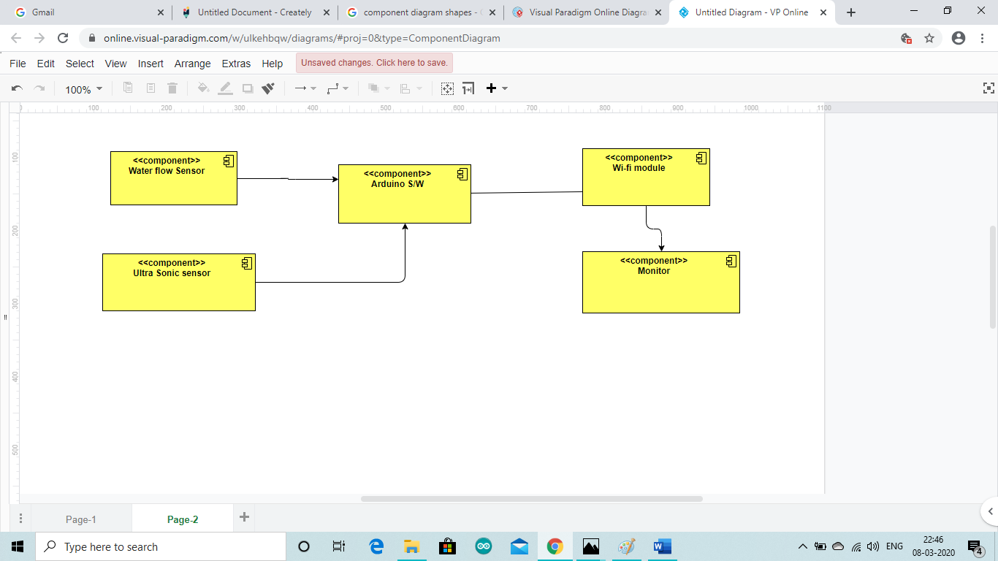
Component diagrams
SMART DRAINAGE MANAGEMENT SYSTEM
Batch -12 16HP1A1224 16HP1A1215 16HP1A1213
MODELING
DEPARTMENT OF INFORMATION TECHNOLOGY

Slide 24

Outputs
Sign-in page of AllThingsTalk
SMART DRAINAGE MANAGEMENT SYSTEM
Batch -12 16HP1A1224 16HP1A1215 16HP1A1213
OUTPUT
DEPARTMENT OF INFORMATION TECHNOLOGY

Slide 25
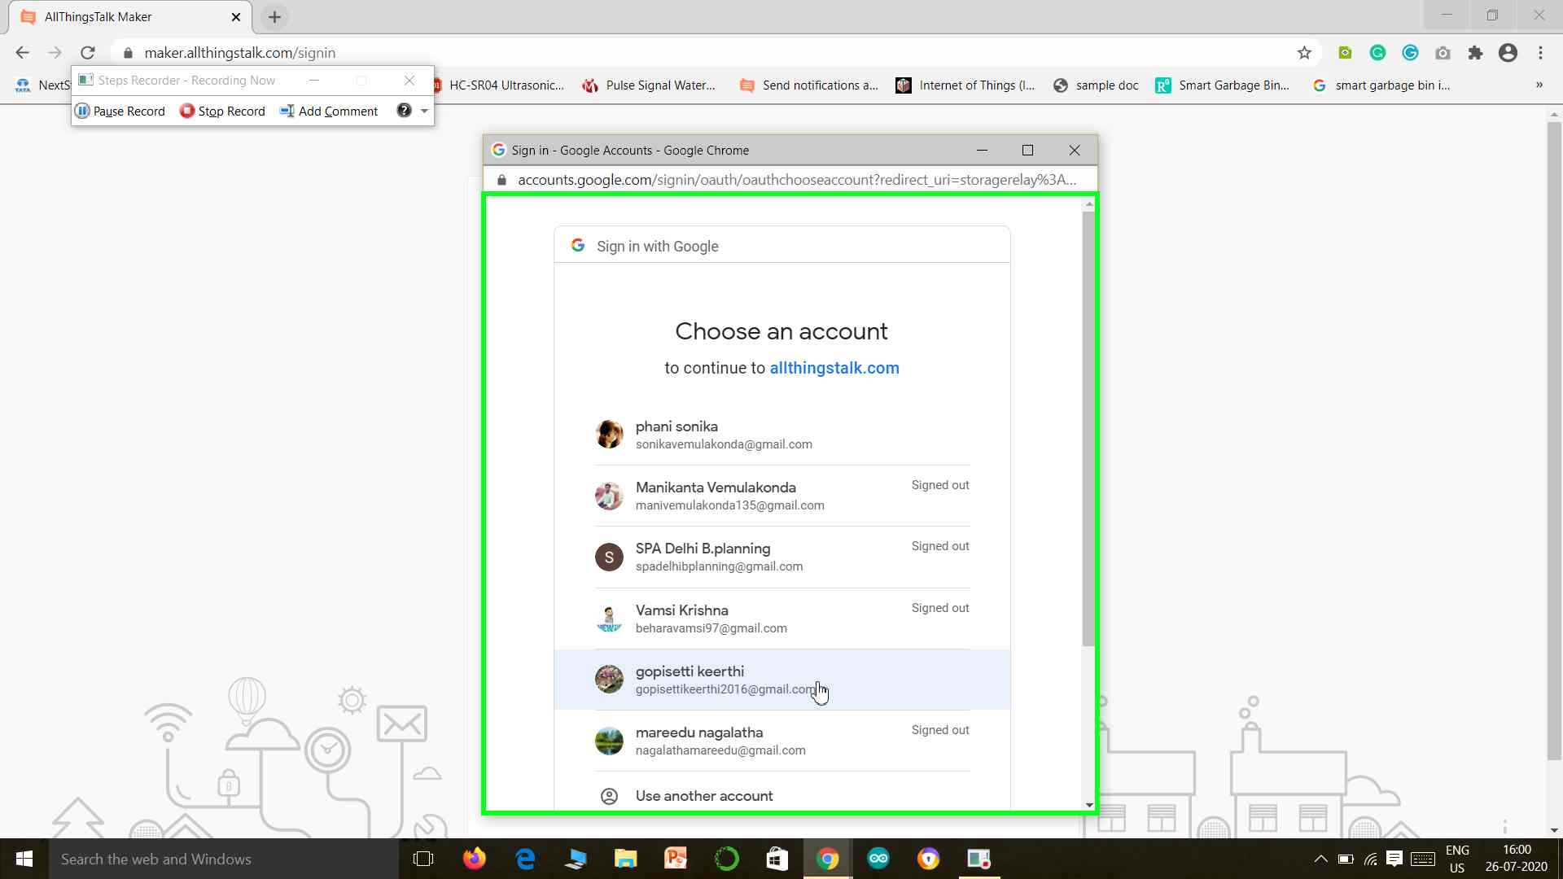
User can login using their mail id’s
SMART DRAINAGE MANAGEMENT SYSTEM
Batch -12 16HP1A1224 16HP1A1215 16HP1A1213
OUTPUT
DEPARTMENT OF INFORMATION TECHNOLOGY

Slide 26
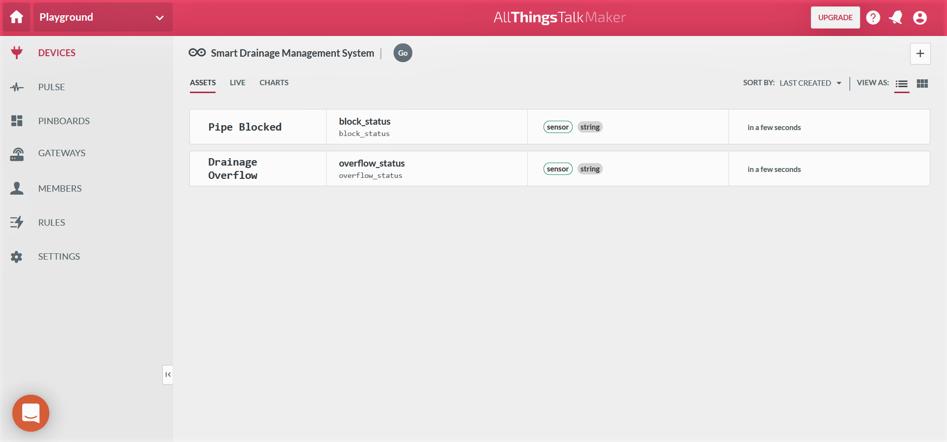
SMART DRAINAGE MANAGEMENT SYSTEM
Batch -12 16HP1A1224 16HP1A1215 16HP1A1213
OUTPUT
DEPARTMENT OF INFORMATION TECHNOLOGY

Slide 27
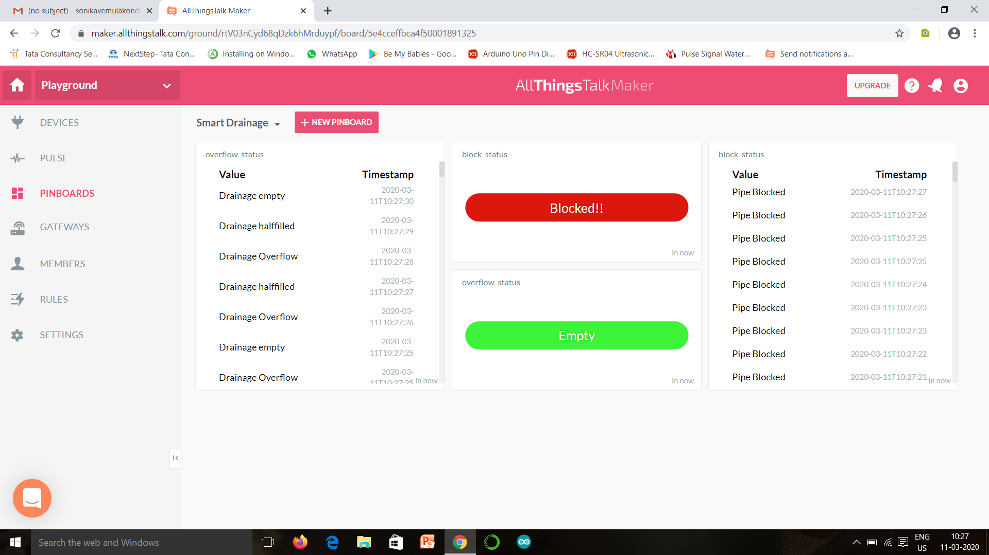
SMART DRAINAGE MANAGEMENT SYSTEM
OUTPUT
Batch -12 16HP1A1224 16HP1A1215 16HP1A1213
DEPARTMENT OF INFORMATION TECHNOLOGY

Slide 28
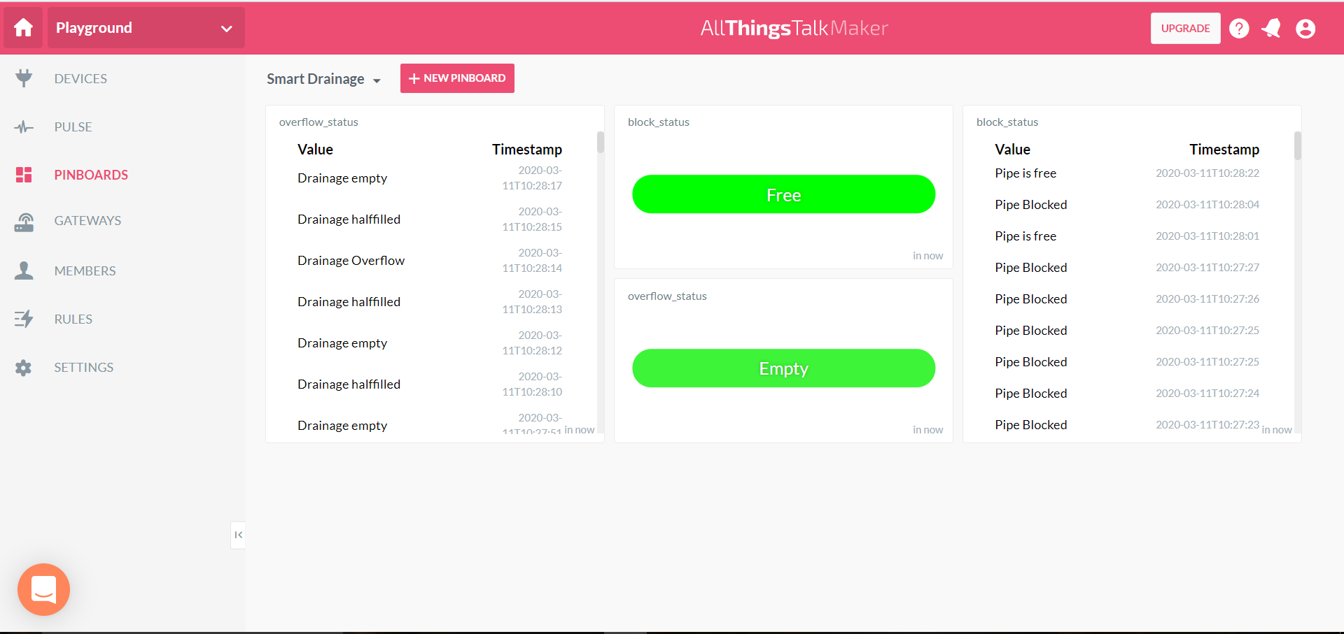
SMART DRAINAGE MANAGEMENT SYSTEM
OUTPUT
Batch -12 16HP1A1224 16HP1A1215 16HP1A1213
DEPARTMENT OF INFORMATION TECHNOLOGY

Slide 29
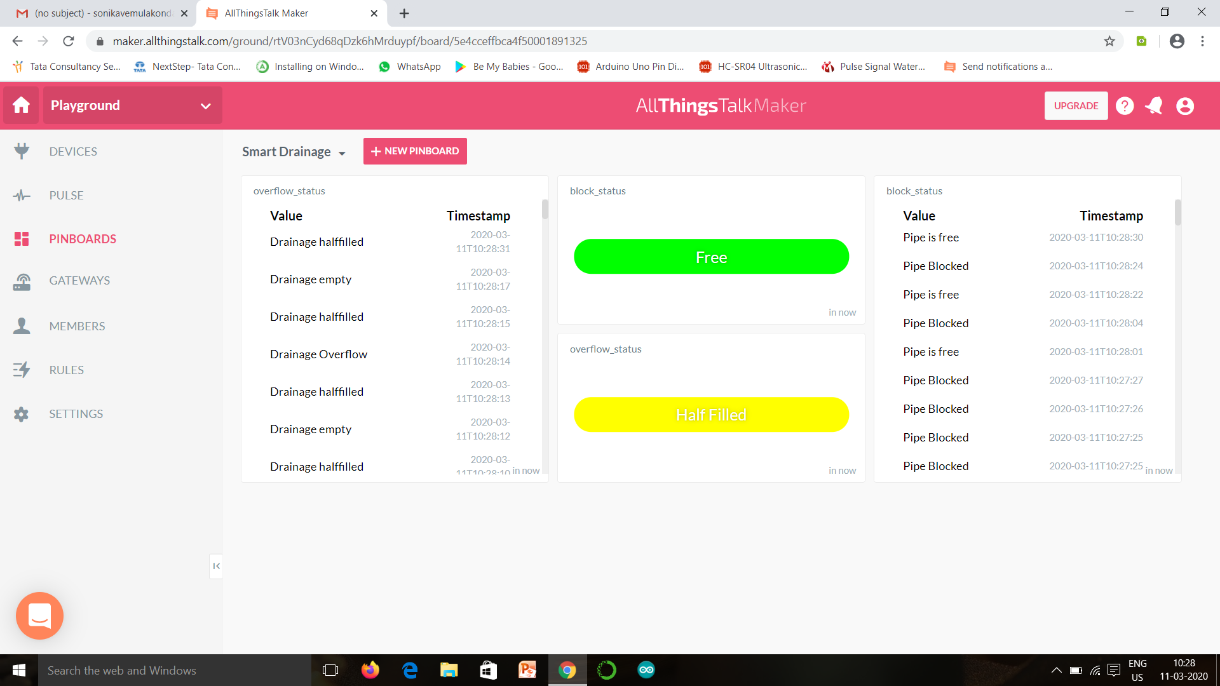
SMART DRAINAGE MANAGEMENT SYSTEM
OUTPUT
Batch -12 16HP1A1224 16HP1A1215 16HP1A1213
DEPARTMENT OF INFORMATION TECHNOLOGY

Slide 30
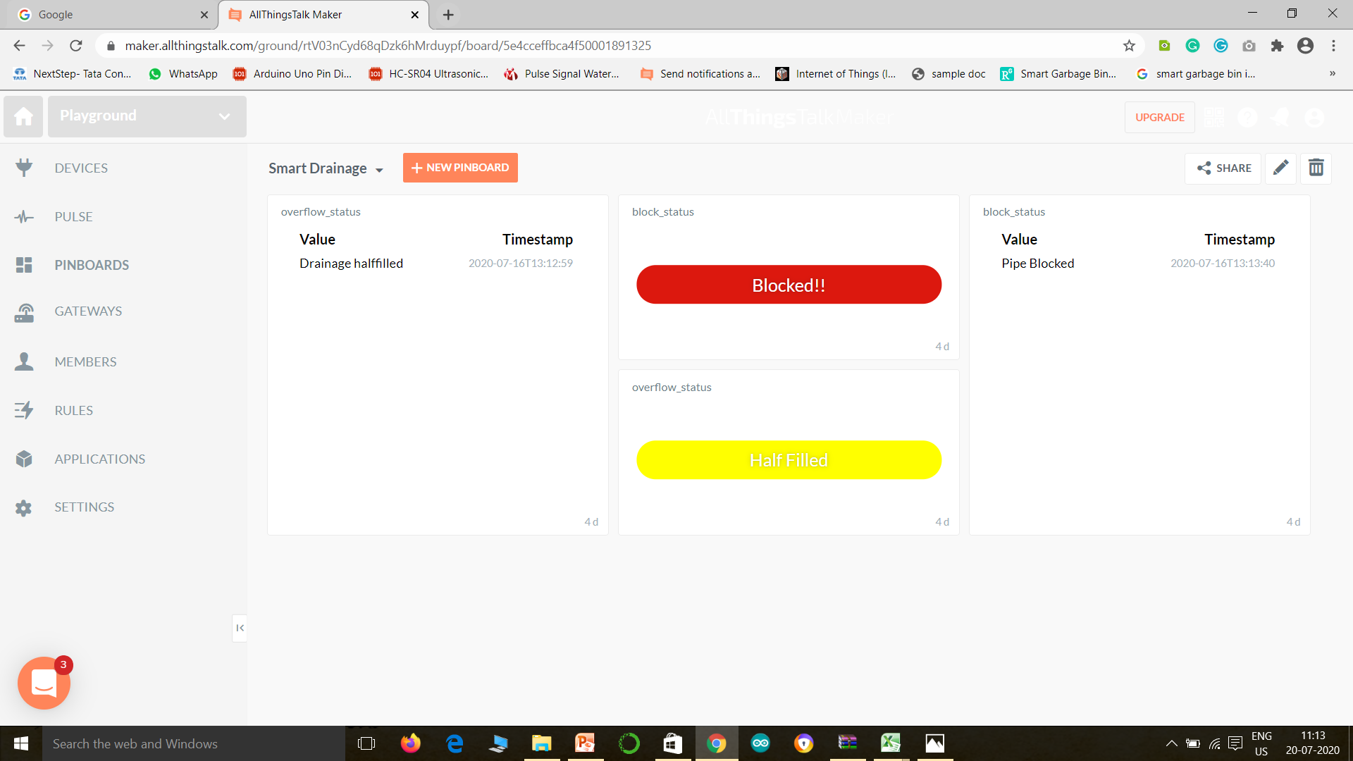
SMART DRAINAGE MANAGEMENT SYSTEM
OUTPUT
Batch -12 16HP1A1224 16HP1A1215 16HP1A1213
DEPARTMENT OF INFORMATION TECHNOLOGY

Slide 31
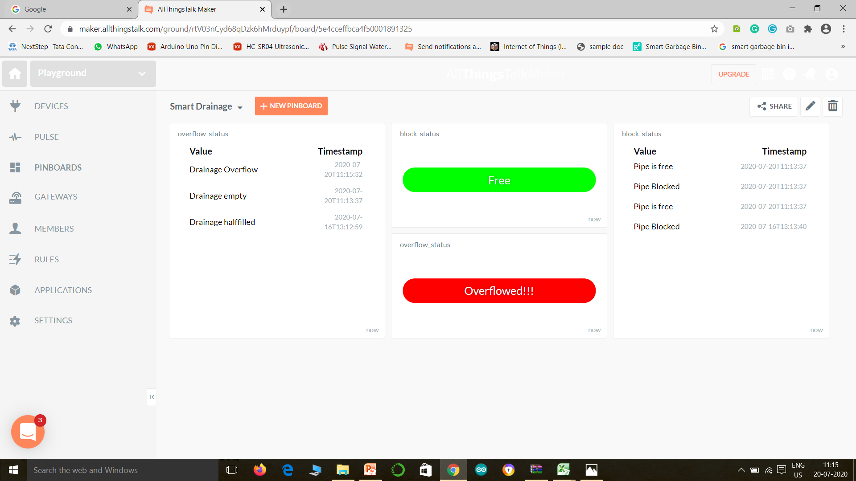
SMART DRAINAGE MANAGEMENT SYSTEM
OUTPUT
Batch -12 16HP1A1224 16HP1A1215 16HP1A1213
DEPARTMENT OF INFORMATION TECHNOLOGY

Slide 32
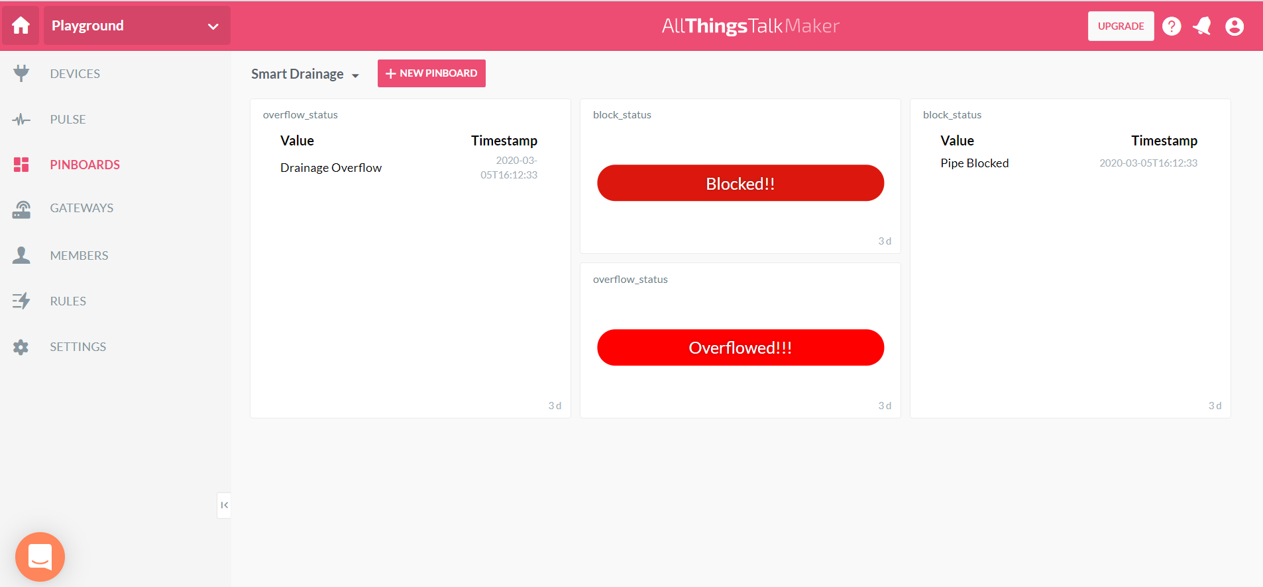
SMART DRAINAGE MANAGEMENT SYSTEM
Batch -12 16HP1A1224 16HP1A1215 16HP1A1213
OUTPUT
DEPARTMENT OF INFORMATION TECHNOLOGY

Slide 33
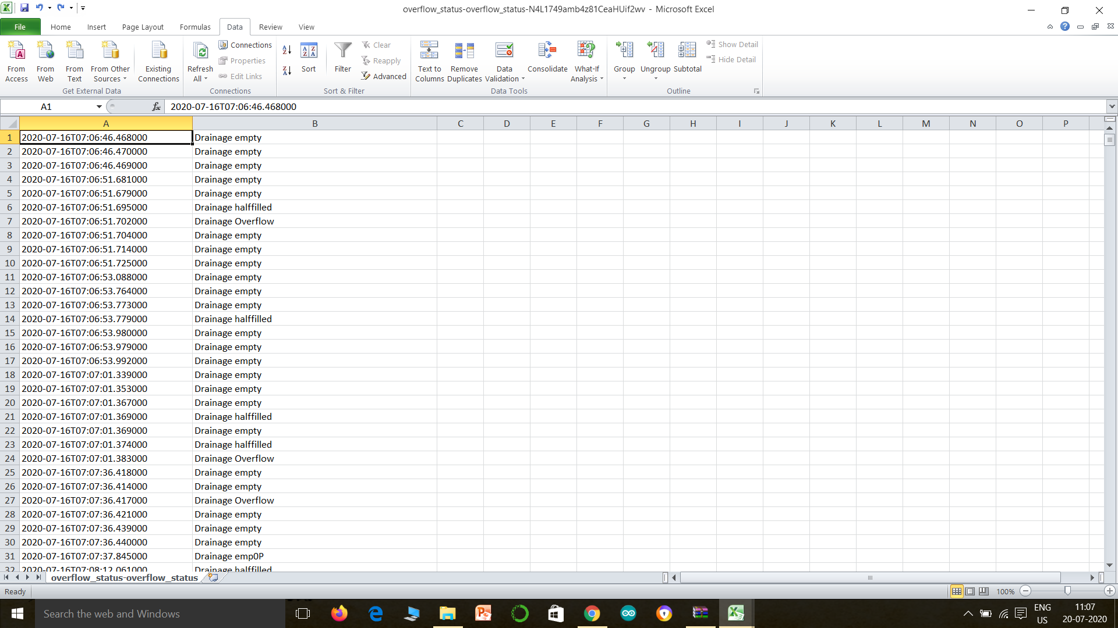
Report Generated for drainage overflow status
SMART DRAINAGE MANAGEMENT SYSTEM
OUTPUT
Batch -12 16HP1A1224 16HP1A1215 16HP1A1213
33
DEPARTMENT OF INFORMATION TECHNOLOGY

Slide 34

Report generated for drainage pipe block status
SMART DRAINAGE MANAGEMENT SYSTEM
34
OUTPUT
Batch -12 16HP1A1224 16HP1A1215 16HP1A1213
34
DEPARTMENT OF INFORMATION TECHNOLOGY

Slide 35
Advantages
It eliminates the manual work.
Indicates the problem before it occurs.
It has very few interconnections.
The embedded system is small in size.
The system is less expensive.
It has fast operation.
It has improved product quality.
It optimizes use of system resources.
It has low power operation.
SMART DRAINAGE MANAGEMENT SYSTEM
Batch -12 16HP1A1224 16HP1A1215 16HP1A1213
ADVANTAGES
DEPARTMENT OF INFORMATION TECHNOLOGY

Slide 36
Conclusion
Sensor networks are considered as the key enablers for the IoT paradigm . This paper addresses all about smart and real-time Drainage monitoring system through IoT applications for metropolitan cities. By using various sensors such as water level as well as blockage detection we can monitor the real time scenario of drainage system by for detecting the problems in drainage system. By doing this we can able to take particular action on the problems as we will receive the early alerts of blockage as well as increase. This paper can be used to design the smart and real time drainage system for monitoring as well as troubleshooting purpose.
SMART DRAINAGE MANAGEMENT SYSTEM
Batch -12 16HP1A1224 16HP1A1215 16HP1A1213
CONCLUSION
DEPARTMENT OF INFORMATION TECHNOLOGY

Slide 37
Thank you
SMART DRAINAGE MANAGEMENT SYSTEM
Batch -12 16HP1A1224 16HP1A1215 16HP1A1213
DEPARTMENT OF INFORMATION TECHNOLOGY

